Slide 1
FAMOUS ROMANIAN EXPLORERS

Slide 2
Nicolae
Milescu
Spătaru

Slide 3
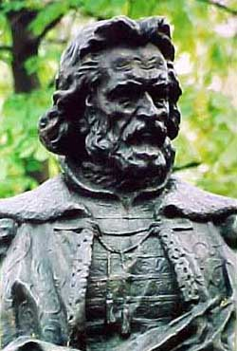
Nicolae Milescu Spătaru (1636 – 1708) was a Moldavian writer, diplomat and traveler.
In 1675, he was named ambassador of the Russian Empire to Beijing, the capital of Qing China, returning in 1678. At the head of a 150-strong expedition that had a military component (meant to fend off possible attacks by a hostile indigenous population), Milescu had as his main tasks the settlement of several border incidents between Russia and China, the establishment of permanent trade relations with China, and the survey of the newly-incorporated Russian lands along the Amur River.

Slide 4
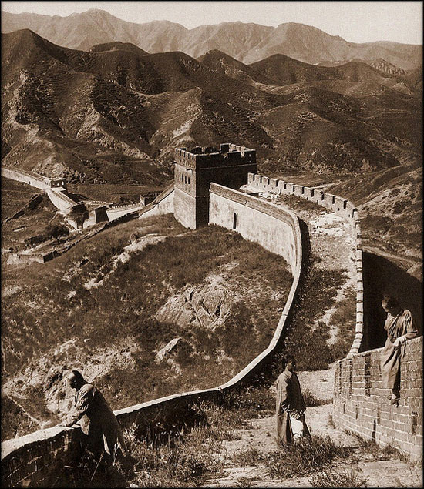
Unlike previous Russians who had gone through Mongolia, Milescu chose to travel through Siberia as far as Nerchinsk, directly north of Peking. Milescu, crossed Manchuria and reached Beijing in the middle of May, after being held up for two months at Kalgan. Here he was able to communicate in Latin with the Jesuit Ferdinand Verbiest. His diplomacy proved unsuccessful, and he returned to Siberia by the same route in Spring 1677.

Slide 5
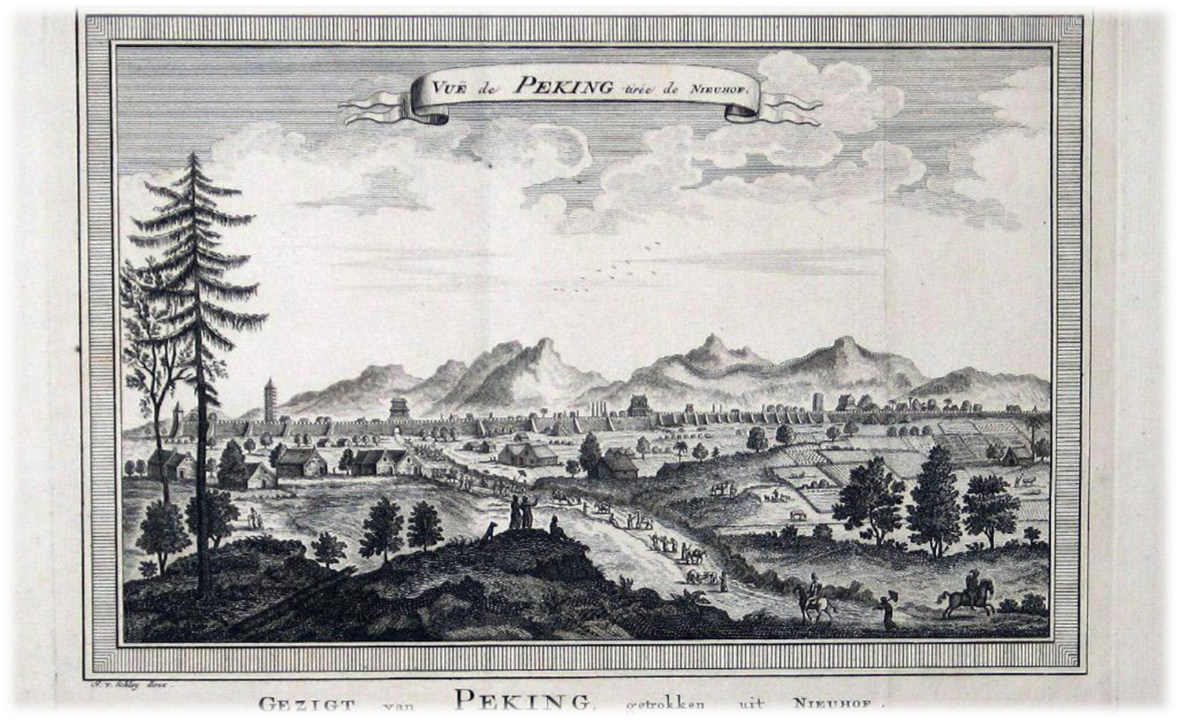

Slide 6
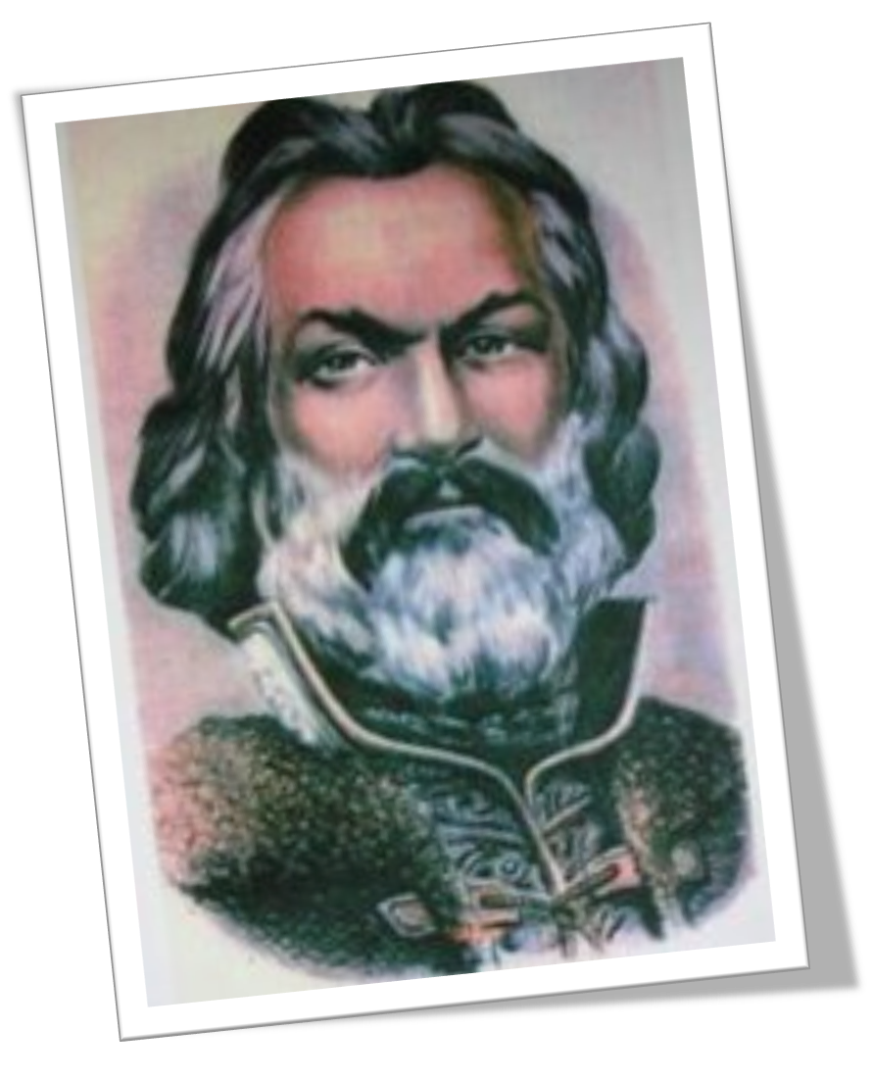

Slide 7
Grigore Antipa

Slide 8
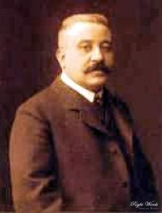
Grigore Antipa (27 November 1867 – 9 March 1944) was a Romanian Darwinist biologist who studied the fauna of the Danube Delta and the Black Sea. Between 1892 and 1944 he was the director of the Bucharest Natural History Museum, which now bears his name.

Slide 9
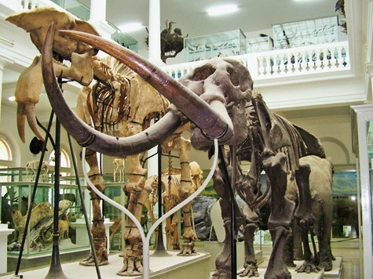
Antipa was a specialist in zoology, ichthyology, ecology and oceanography, and was a university professor.

Slide 10
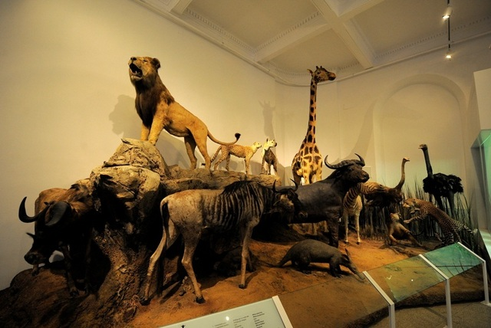
He was elected as member of the Romanian Academy in 1910 and was also a member of several foreign academies. He founded a school of hydrobiology and ichthyology in Romania.

Slide 11
Emil Racoviţă

Slide 12
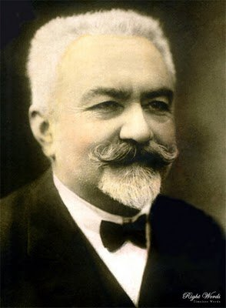
Emil Racoviță (15 November 1868 – 17 November 1947) was a Romanian biologist, zoologist, speleologist, explorer of Antarctica and the first biologist in the world who studied the arctic life.
As a promising young scientist, Racoviță was selected to take part in an international team that started out on a research expedition to Antarctica, aboard the Belgica, a former Norwegian wooden whaler . The expedition was led by the Belgian officer Adrien de Gerlache.

Slide 13
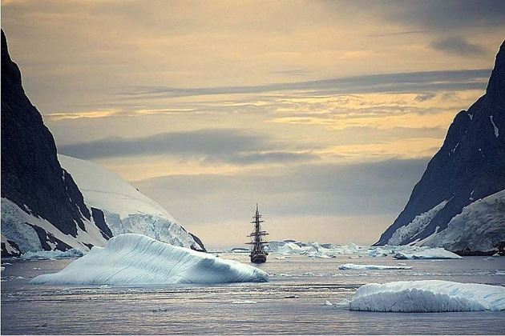
The 19 members of the team were of various nationalities, a rare thing for that time. The first mate of the vessel was Roald Amundsen (who was to conquer the South Pole in 1911).
Racoviță was the first researcher to collect botanical and zoological samples from areas beyond the Antarctic Circle.
Belgica made the first daily meteorological recordings and measurements in Antarctica, every hour, for a whole year. The scientists also collected information on oceanic currents and terrestrial magnetism, with as many as 10 volumes of scientific conclusions being published at the end of the expedition, which was considered a success.

Slide 14
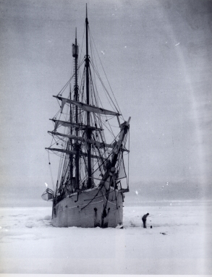
Belgica returned to Europe in 1899 without two team-members, who had died during the expedition.
Racoviță’s diary, published in 1899, makes mention of the difficulties that the team-members had to endure. The results of his research were published in 1900, under the title “La vie des animaux et des plantes dans l'Antarctique” ("The life of animals and plants in Antarctica”).

Slide 15
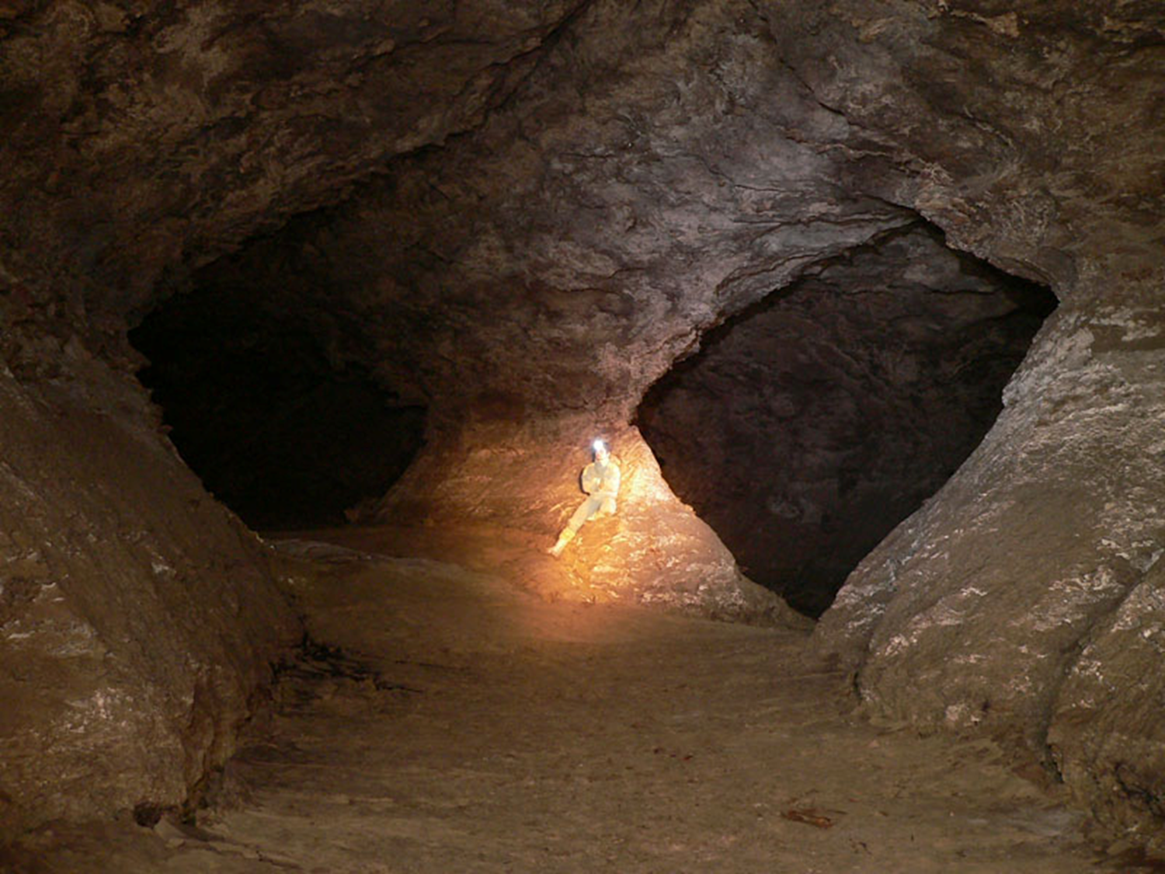

Slide 16
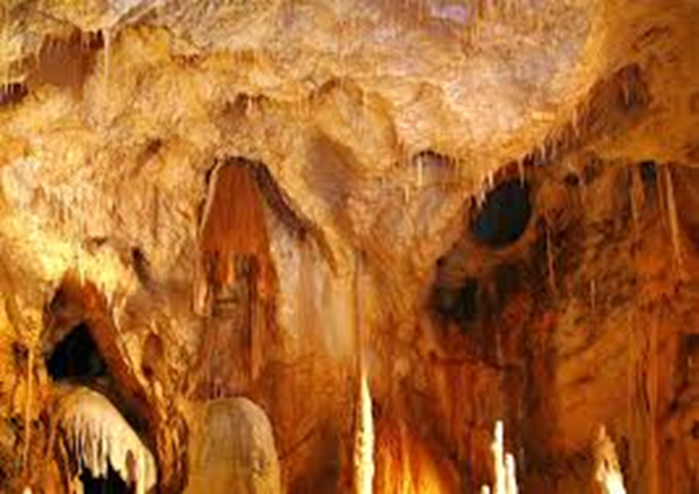

Slide 17
Maria Uca Marinescu

Slide 18
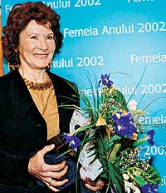
Born in Gheorghieni on the 15th of May 1940, Professor Maria Uca-Marinescu is now the foremost Romanian female explorer of all time having become famous as the first woman of any nation to walk Africa from top to bottom alone and without help and the first Romanian to walk to both North and South Poles.
In 2003 she was the President of the Olympic Commission for sport and medicine and is also a member of the Romanian Olympic committee.

Slide 19
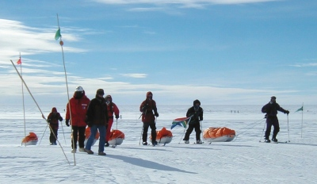
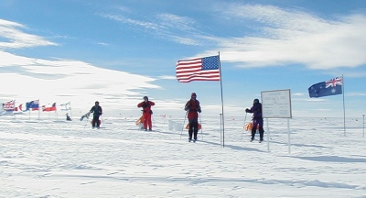
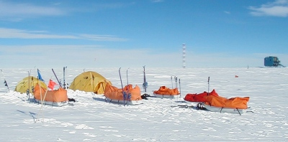
In December 2001 she was part of the International "Ski the Last Degree" Expedition which arrived by ski at the South Pole. The expedition team of 2 guides and 5 individuals had earlier flown by Adventure Network International aircraft to a location 60 miles north of the South Pole from where they skied the last 60 miles to the Pole arriving on Christmas Day 2001.
After arriving at the South Pole, the "Ski The Last Degree Expedition" set up a temporary tent camp while they joined in Christmas festivities with the Americans at the South Pole including witnessing the annual race around the world. After a few days the expedition was picked up by an Adventure Network aircraft and flown to Patriot Hills before flying back eventually to Punta Arenas in South America.

Slide 20
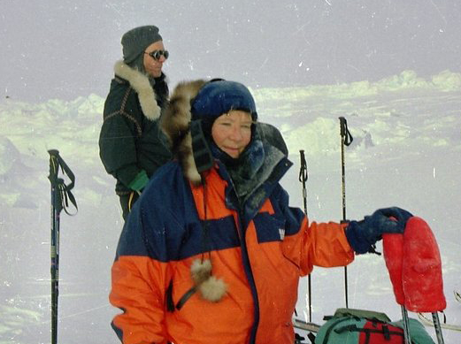

Slide 21
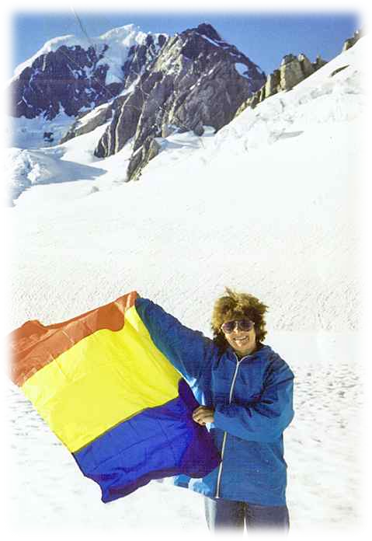
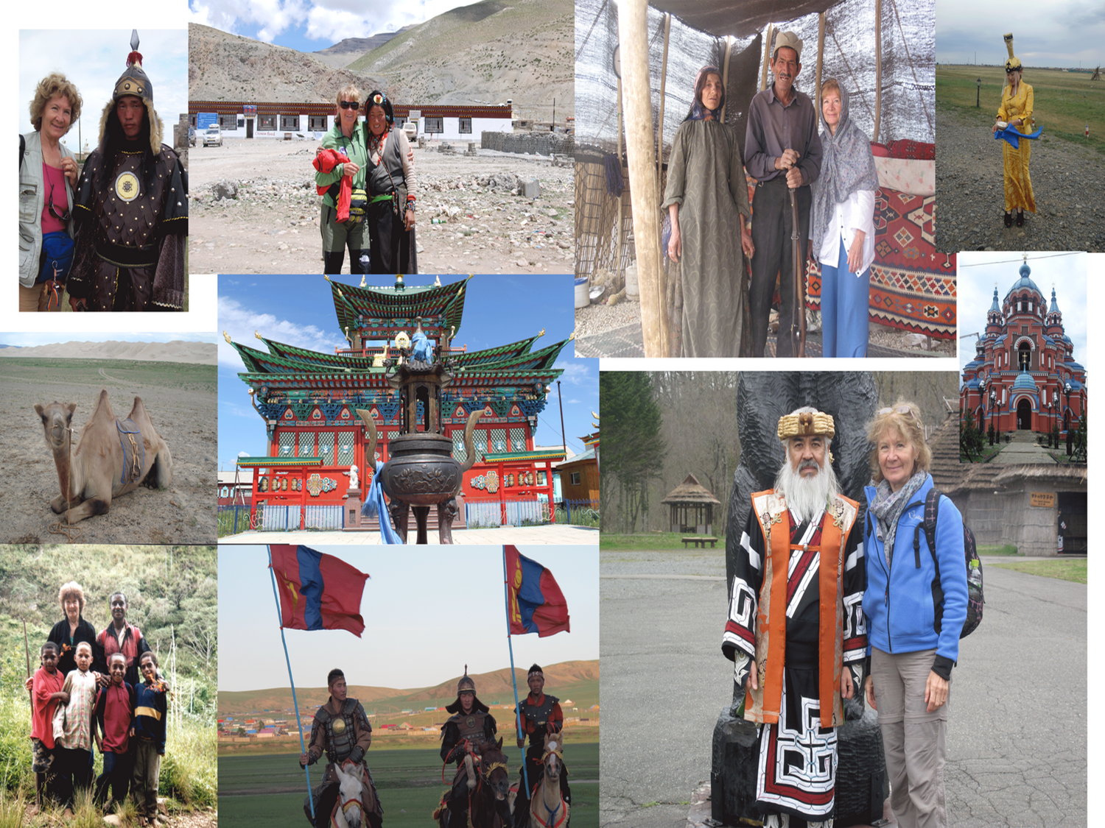
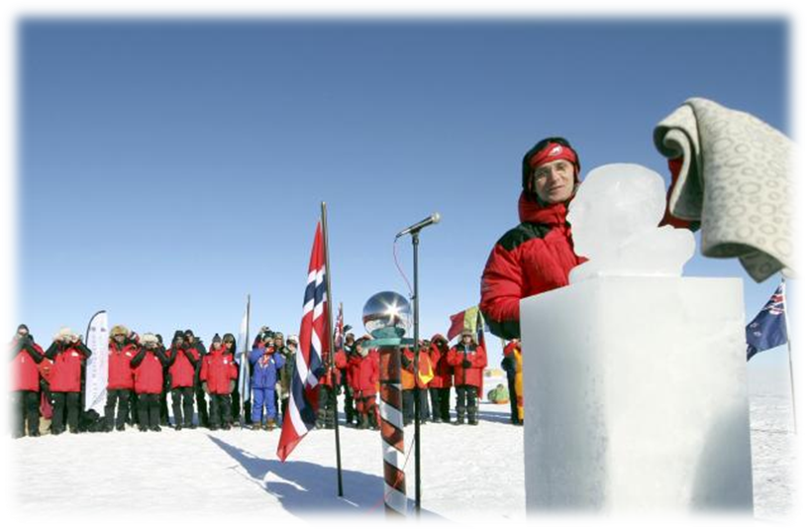

Slide 22
Tulit Zsombor

Slide 23
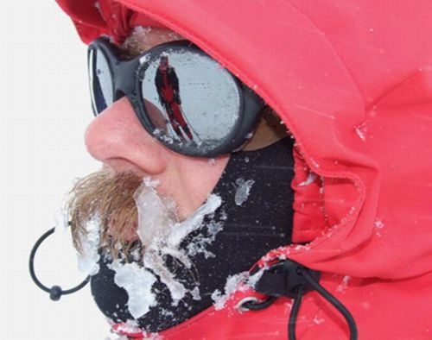
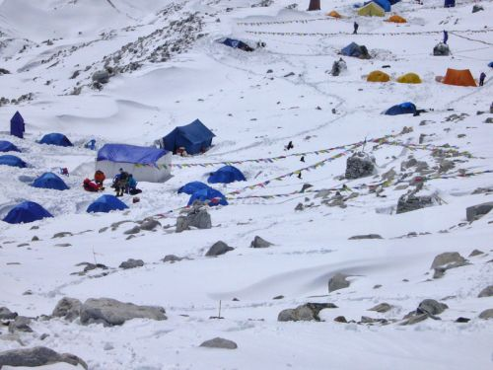
Tulit Zsombor is one of Romania’s most experienced alpinist. He is 33 years old and he had already climbed Triglav (Slovenia), Ercyes (Turkey) , Mont Blanc (France) , Elbrus (Russia) , Lenin (Kyrgyzstan), McKinley (Alaska), Matterhorn (Elveţia), Aconcagaua (South America), McKinely (North America), Kilimanjaro (Africa) and Vinson (Antarctica). He also holds the national record for descenting on skis from 6,400 metres.

